Slide 1
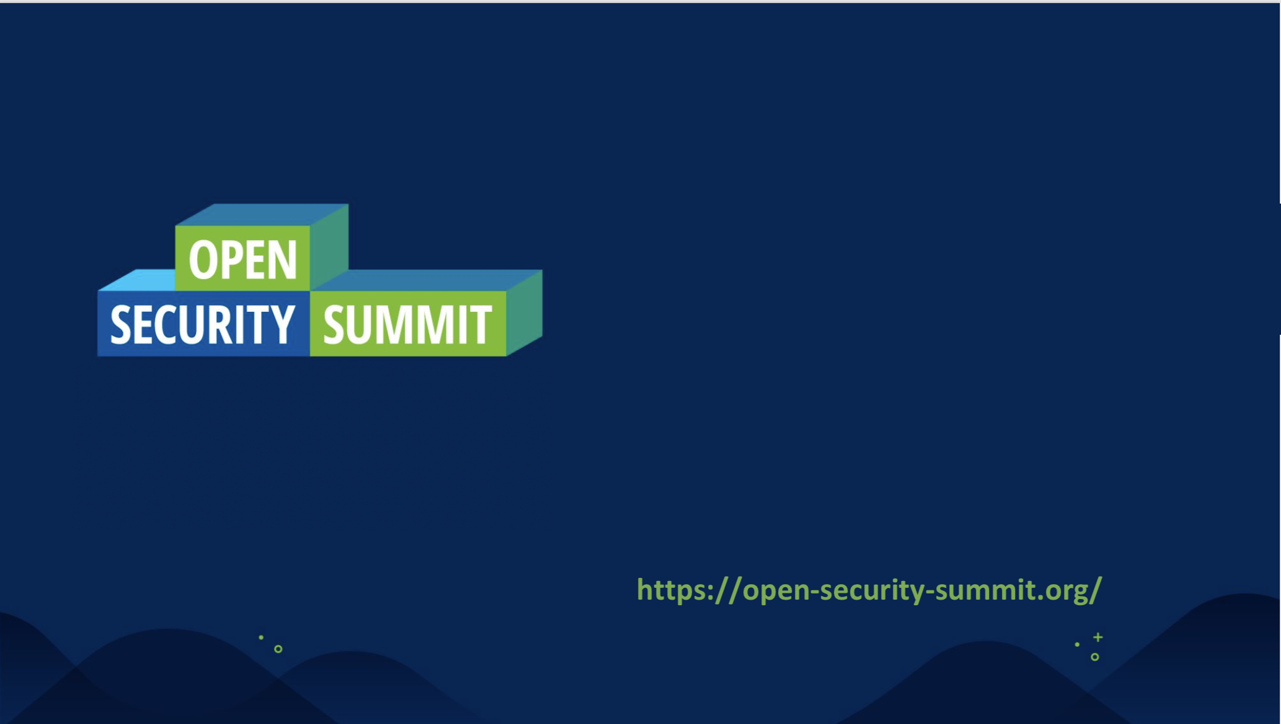
MultiJuicer Introduction

Slide 2
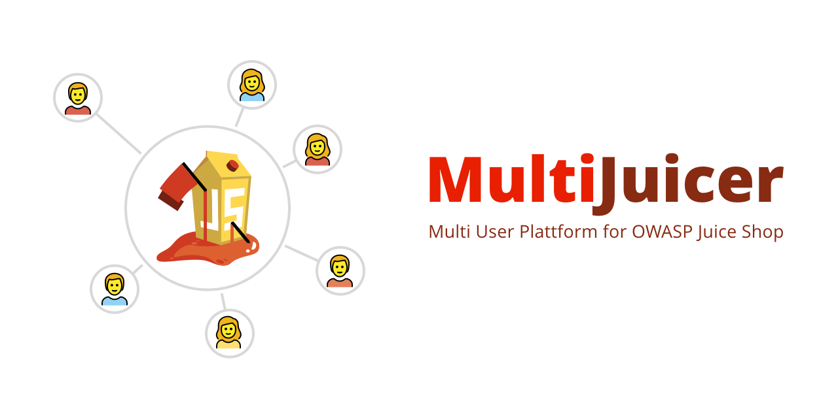

https://github.com/iteratec/multi-juicer

Slide 3






Robert Seedorff CISO @ iteratec OWASP Member
Jannik Hollenbach Security Engineer @ iteratec OWASP Juice Shop Core Team
@r_seedorff
@rseedorff
@j12934
@j12934
Notes:
Short introduction about us and our job at iteratec

Slide 4
Our passion is to deliver secure software because we believe that secure software development is crucial in a digital world
Developing secure software is not that hard as developer often might think
It all starts as always with a shared mindset + culture, learning by doing and of course developer trainings 😉
Notes:
Start with why we are doing this as a company

Slide 5
🤔 How do you do hands-on security trainings?
Notes:
Ask the participants?

Slide 6

With OWASP Juice Shop, obviously 😉
95+ Challenges with lots of variability
Realistic challenges
Interactive Hacking Instructor for newbies
Open Source

Slide 7
But How?

Slide 8
Option 1: Local Installation
Just clone the repo and run “npm install”

Slide 9
💣 Anything that can go wrong will go wrong
Can I use my 5 year old Node.js 4 Installation?
I’m not allowed to install Software on my Enterprise Windows 95 Laptop
I already have something running on port 3000
I don’t have Node.js
Why is my fan spinning up?
What is a terminal?
The NPM install is crashing
It says it’s running but i can’t access it via localhost:3000
Is it normal that this takes 15 minutes?
My enterprise npm installation is only allowed to fetch packages from our enterprise package repository

Slide 10
😕
Local Installation is a great way to waste the first hour(s) of your security training
Notes:
Add the end, the will be at least one participant setup which didn't work

Slide 11
Option 2: Central Hosting
Host all Instances in a Cloud(ish) environment.

Slide 12
Trivial Solution
Start 10 Instances via Docker & Bash (From Pwning Juice Shop):
for i in {10..19}; do docker run -d -p 40$i:3000 bkimminich/juice-shop; done
That’s totally fine!
But comes with some downsides:
You need to distribute the addresses
Corporate firewall blocking random ports
Not “cheat proof”, users can enumerate the ports to find the other instances
Hard for organisers to keep an overview over the instances
You need to know how many participants you’ll have in advance or add instances by hand
Running multiple trainings in parallel might be a hassle
Don’t forget to cleanup everything afterwards

Slide 13
Option 3: Central Hosting based on
Runs on a single domain, comes with a Load Balancer sending the traffic to the participants Juice Shop instance
Dynamically create new Juice Shop instances when needed
Juice Shop instances are “isolated” from each other to prevent cheating
Backup and auto apply challenge progress in case of Juice Shop container restarts
Cleanup old & unused instances automatically

Slide 14
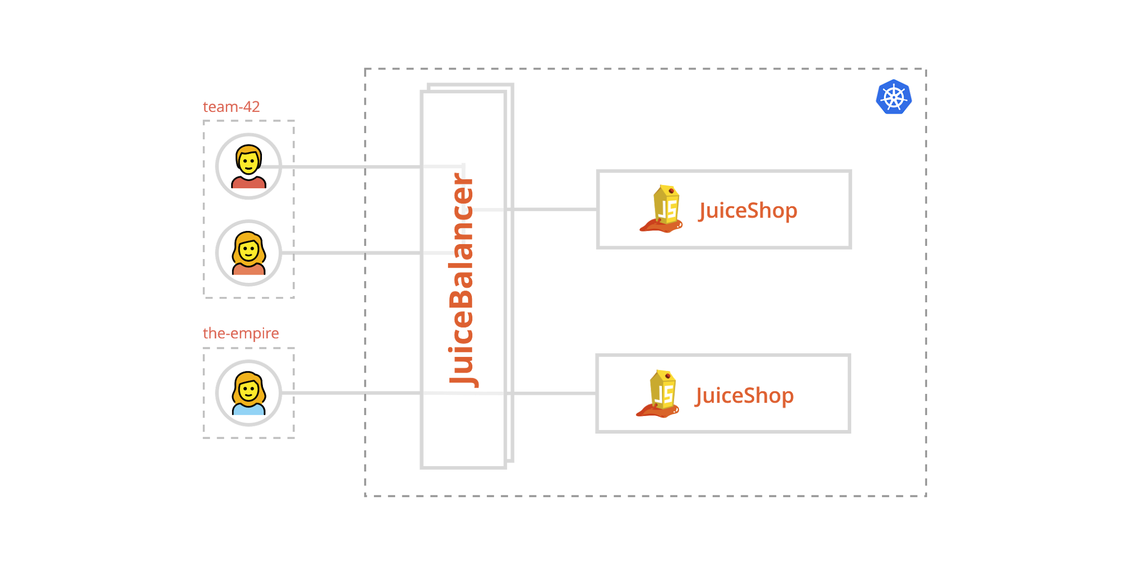
How it works

Slide 15
🚀 Demo 🚀
Notes:
https://multi-juicer.oss2020.security.iteratec.dev

Slide 16
Training Setup Comparison
 | Option #1 Local Installs | Option #2 “docker run ...” Hosting | Option #3 MultiJuicer
👍 | Managed by Participants Nothing to manage by you | Saves time during training Easy Setup | Saves time during training Single address Monitorable Scales automatically Somewhat cheat proof Automatically cleans up instances after trainings
👎 | Time Intensive during trainings Need to be a node expert | Managed by you Hard to monitor Multiple addresses Might be blocked in corporate networks | Managed by you Need to maintain kubernetes cluster

Slide 17
Questions 🧐?

Slide 18
Topics for the DeepDive Session (15 June 2020, 6:00 pm CEST)
How to install and configure MultiJuicer?
Guides based on AWS, GCP, DigitalOcean, Azure already available
How to customize the MultiJuicer + JuiceShop?
How you track the progress of the hackers?
Which metrics are missing?
Implementation details regarding kubernetes
Your suggestion: tell us now or write us later 😀
Notes:
More ideas for deep dive topics:
How to integrate additional learning material for training participants?
Multiple isolated training setups in one cluster?
Long Running setups (365d a year)
Implementation details regarding kubernetes ? Labels, State Persistence,..

Slide 19
How you can help?
👩‍💻 Try it out!
⭐️ Star the repo
🐛 File issues
🧾 Write setups guides for your favorite cloud
📢 Share your feedback and experience with us
github.com/iteratec/multi-juicer

Slide 20
Thanks for listening, stay safe!
github.com/iteratec/multi-juicer

